Slide 1
ECOX5004 Economic Policy Analysis & Evaluation
Presentation Title: Assessing the impact of education on GDP output per capita across European nations
Name: Jack O’Callaghan

Slide 2
What we are looking for when grading your ability to..
Briefly introduce your Policy Question. You're looking at the Impact of MWs (in what form?) ON which Y(?)
Describe and convey the importance of your question succinctly.
Present your (preliminary) results in a clear and succinct way
Describe the weaknesses and problems in these results (e.g. Measurement problems, omitted variables etc)
Justify a plan for an alternative estimation strategy that can address some of these problems, if you have attempted this, present preliminary results too
Do not worry about the ‘quality’ of your estimate, what matters is the care with which your report your results,
if you’re confident a result is good, then tell us so and briefly say why you think that
if you think the result is weak, or should not be trusted, then state why and be sure not to over-claim it’s importance!

Slide 3
1. To Recap, My Question is:
My hypothesis is that an increase in the average number of years of education that a citizen receives leads to an increase in a country’s per-capita output-side real GDP in US Dollars.
For my baseline model, my X (policy) variable is average number of years of education and my Y (impact) variable is per-capita output-side real GDP.
My analysis dataset is a joined combination of World Bank, Barro & Lee, and Penn World Tables data.

Slide 4
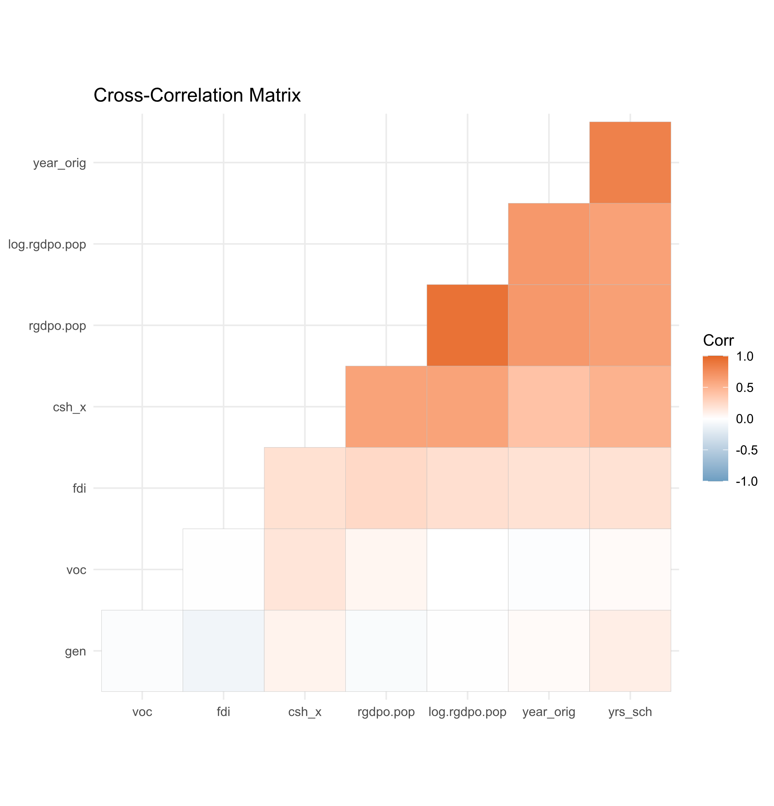
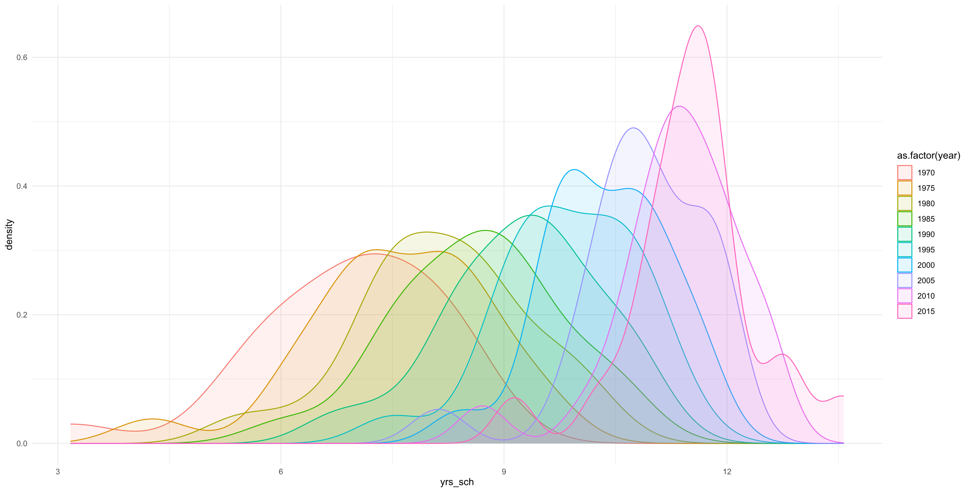
Summary stats for the data used
Looking first at the density plot, we can see that years of education (yrs_sch) has a singular modal value for most years. Also there doesn’t seem to be much skew. Becoming more mesokurtic?
As one might expect, real GDP output per capita and the log-transformed version are highly correlated.
Interestingly, both versions of the real GDP output per capita variable are highly correlated with both number of years since 1970 (year_orig) and years of education (yrs_sch). Add more here?
Variable | Minimum | 1st Q. | Median | Mean | 3rd Q. | Maximum | Standard Deviation
rgdpo.pop | 3,002.00 | 15,534.00 | 23,531.00 | 25,538.00 | 33,447.00 | 82,382.00 | 14,031.57
log.rgdpo.pop | 8.01 | 9.65 | 10.07 | 9.99 | 10.42 | 11.32 | 0.60
yrs_sch | 3.17 | 8.16 | 9.64 | 9.45 | 10.93 | 13.57 | 1.84
avh | 1,401.00 | 1,627.00 | 1,766.00 | 1,778.00 | 1,903.00 | 2,334.00 | 207.67
csh_x | 0.00 | 0.16 | 0.27 | 0.34 | 0.49 | 1.22 | 0.24
fdi | -15.71 | 0.58 | 1.95 | 10.36 | 5.39 | 340.26 | 31.16
ctfp | 0.45 | 0.76 | 0.87 | 0.88 | 0.98 | 1.44 | 0.18

Slide 5
Results from your first estimation
Input key results - including Parameters, t statistics and other key statistics into a simple table here
If you have done more than one similar regression (e.g. some with controls, some without include this here)

Slide 6
Discussion of your results
Key take aways from these regression and a comparison of results where appropriate
If you have employed any pre-test or hypothesis testing procedure – just include the qualitative interpretation of the test (and the name of the test conducted)
What do the results mean,
Are the results statistically significant
Are they economically important
can you use them to answer your question?
A discussion of the problems/weaknesses of your methodology

Slide 7
Your plan for the next steps
Describe your next estimation strategy and make it clear which problems it will address – it does not have to solve all of them
If you have made a start at this already you can describe what you have done here (in a similar way) to what you did previously

Slide 8
Suggestions for future work
What remains the biggest problem in your analysis to-date (i.e. what would you do differently if you started to answer this question afresh)?

